Slide 1
Design Masterclass Group 1
Design Masterclass.
Ubisoft.
Samuel Cook and Will Terry.

Slide 2

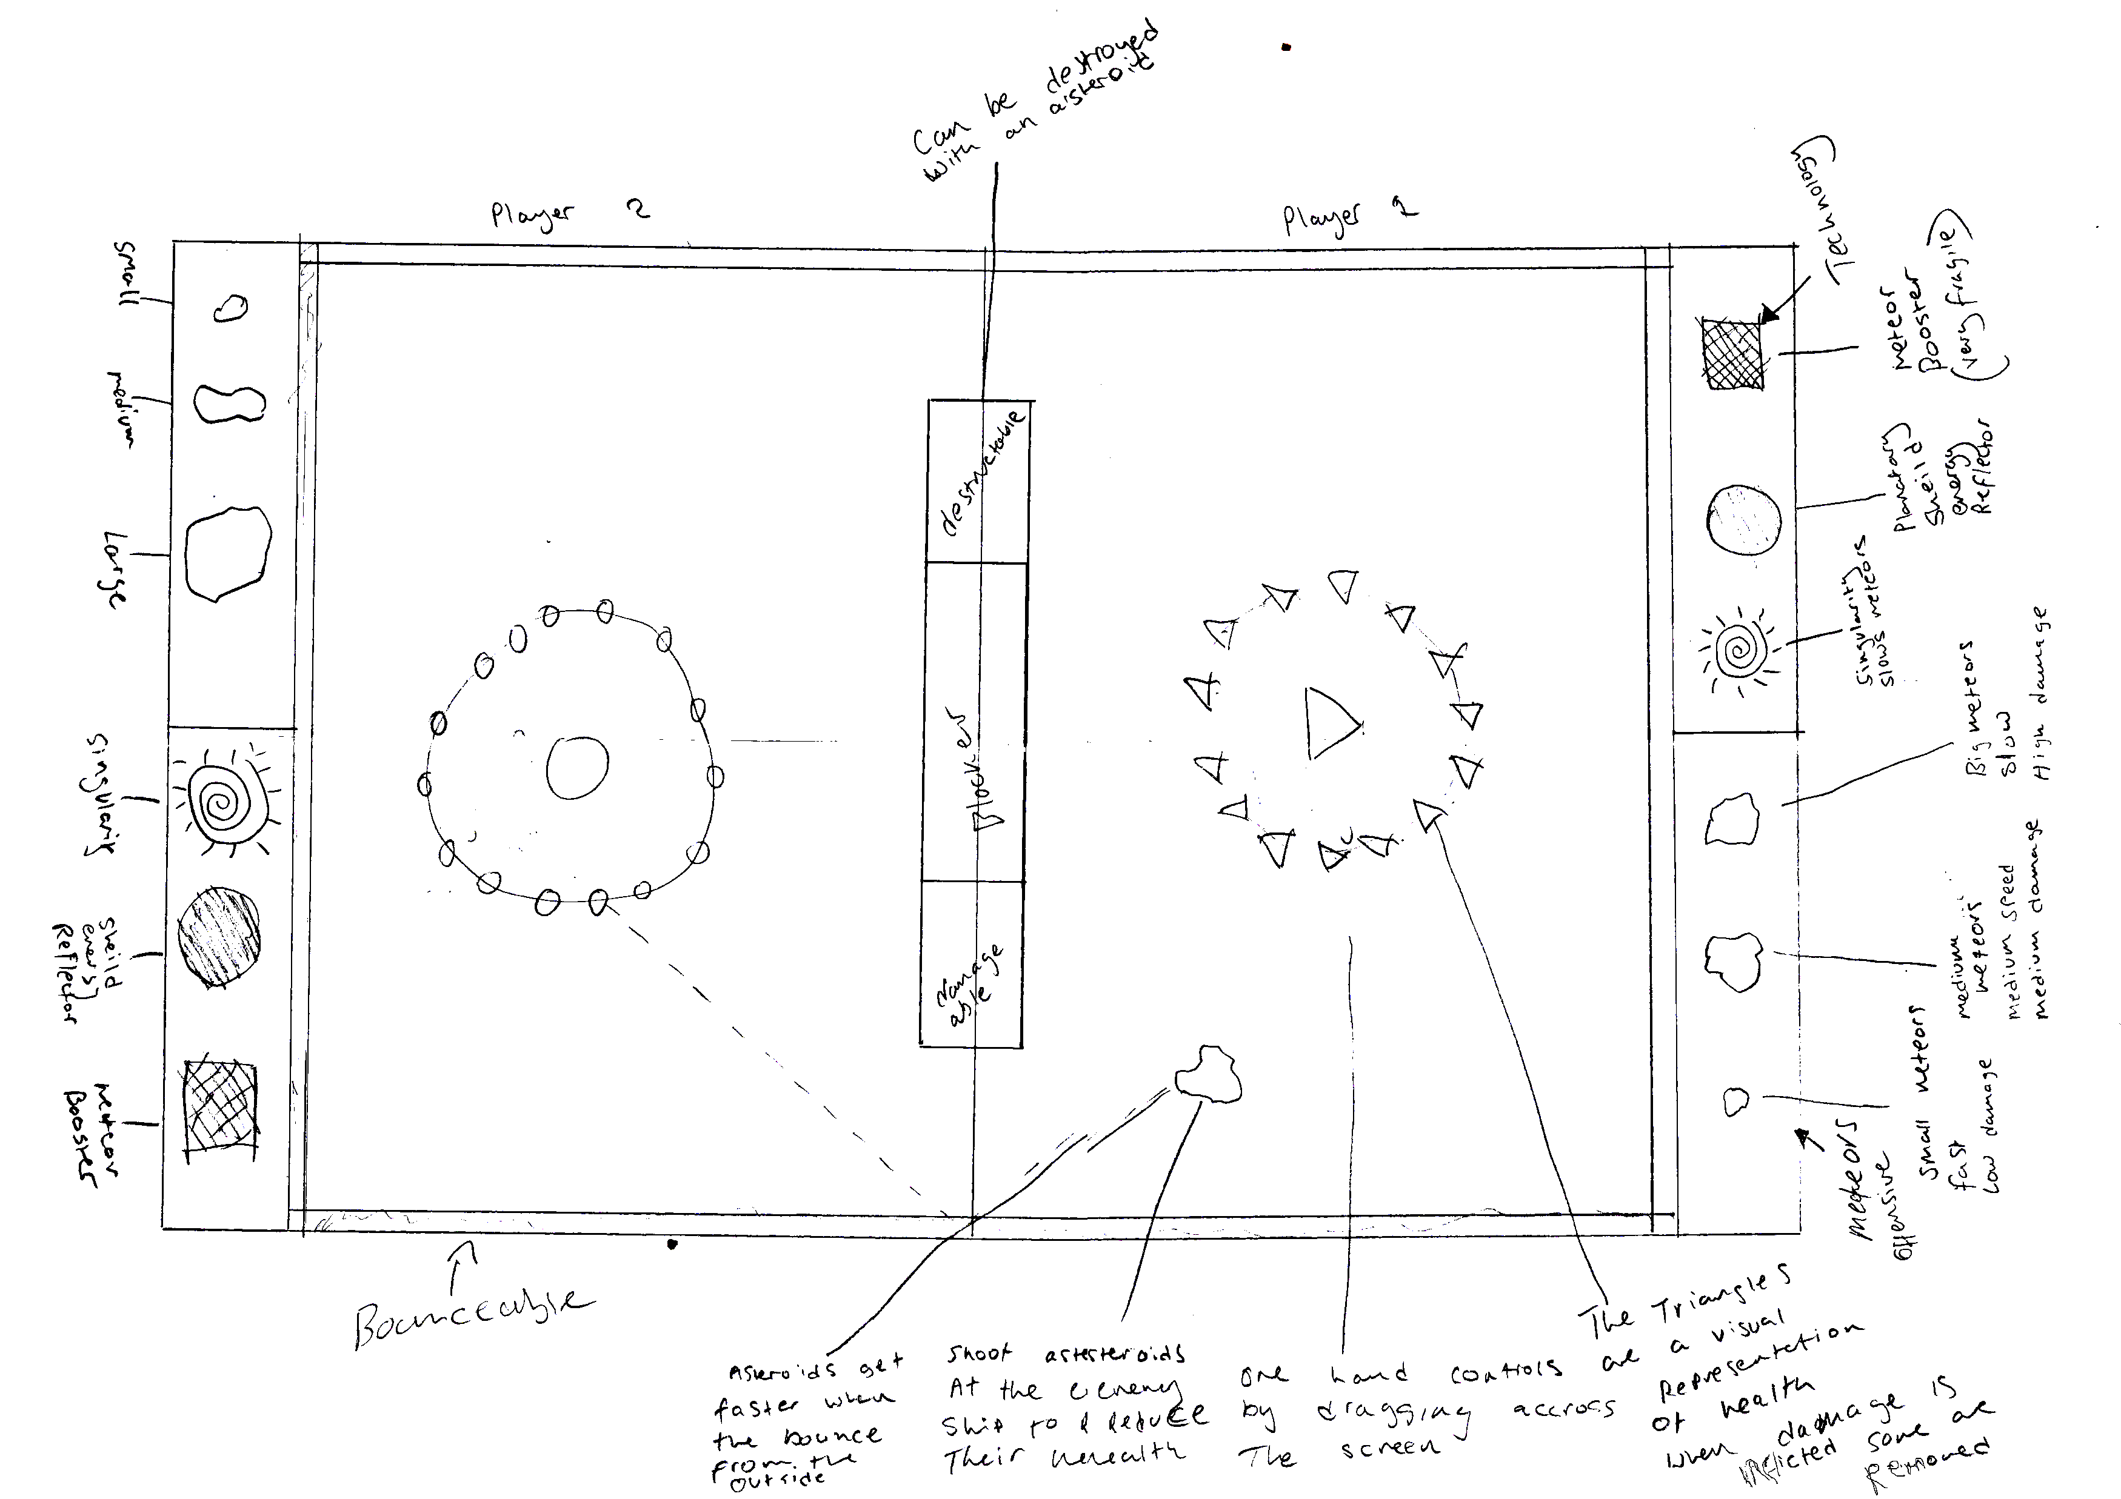
Elements we want in our Game
Trial and Error.
Simple Controls.
Simultaneous play.
Bouncing/Richochet.

Slide 3
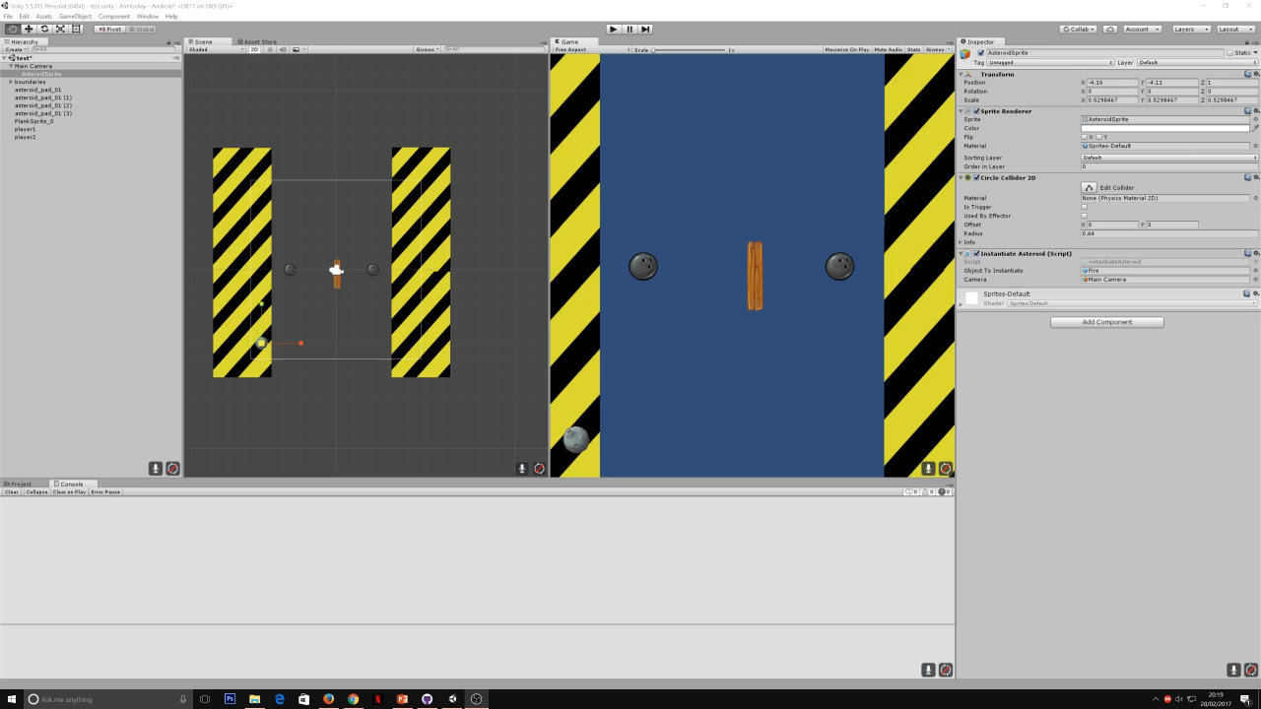
Prototype Two

Slide 4



Prototype Three

Slide 5
Conclusion

Slide 6
Questions?

